Slide 1

Key Partners and Strategic Relationships
Tredence maintains strategic partnerships with major cloud and data platforms through co-innovation models that develop industry-specific accelerators, joint customer programs, and reference architectures to reduce implementation time and risk for enterprise clients.

Slide 2
Hyperscaler Partnerships
Tredence maintains strategic partnerships with major cloud and data platforms:
Google Cloud Platform (GCP)
Databricks
Snowflake
Relationship Scope: Premier Databricks partner with 250+ certified architects and 10+ approved accelerators in Brickbuilder program
Relationship Scope: Tredence Snowflake Center of Excellence with 250+ Snowflake-certified architects and 10+ approved accelerators
Relationship Scope: Tredence is a certified GCP Premier Partner and 2025 Google Cloud Partner Award winner for CPG industry solutions
Scope Details: ATOM.AI platform built on Databricks Lakehouse; certified solutions include On-Shelf Availability (OSA) and Sancus accelerators; 50% faster deployment through Delta Lake integration
Scope Details: Migration services from legacy platforms, advanced analytics implementation, AI/ML productionization at scale
Scope Details: Tredence has embedded GCP technologies (Vertex AI, BigQuery, Cloud Composer, Data Proc) in Customer Cosmos platform, maintaining 200+ models using Google's ML ecosystem
Why Partnership: Snowflake's elastic infrastructure supports Tredence's scalability requirements for Fortune 500 clients
Why Partnership: Google's AI/ML capabilities complement Tredence's last-mile adoption focus; unified platform reduces implementation complexity
Why Partnership: Databricks' unified analytics approach aligns with Tredence's data engineering capabilities; accelerators reduce time-to-value by 50%

Slide 3

Additional Cloud Platform Partners
Amazon Web Services (AWS)
Microsoft Azure
Relationship Scope: Microsoft ecosystem partner for Test and Learn Platform (TALP) and Unified Marketing Platform
Relationship Scope: Strategic AWS Partner providing cloud data warehouse, migration, and analytics services
Scope Details: Native Azure components (Azure Data Factory, Data Lake Storage, Analysis Services)
Scope Details: Services include CloudWatch/EventBridge monitoring, AWS DMS/Glue data movement, real-time streaming on MSK/Kafka infrastructure
Why Partnership: Azure's enterprise integration capabilities align with large enterprise customer base
Why Partnership: AWS's comprehensive service portfolio enables end-to-end modernization solutions

Slide 4


Strategic ISV/Consulting Partnerships
In April 2025, Tredence acquired Further Advisory, a banking and financial services consulting specialist, expanding consulting depth in BFSI with 150+ professionals focused on strategy, technology transformation, and go-to-market expertise.
Scope of Relationships: All partnerships operate on a co-innovation model where Tredence develops industry-specific accelerators, joint customer programs, and reference architectures that leverage partner platforms to reduce implementation time and risk for enterprise clients.

Slide 5
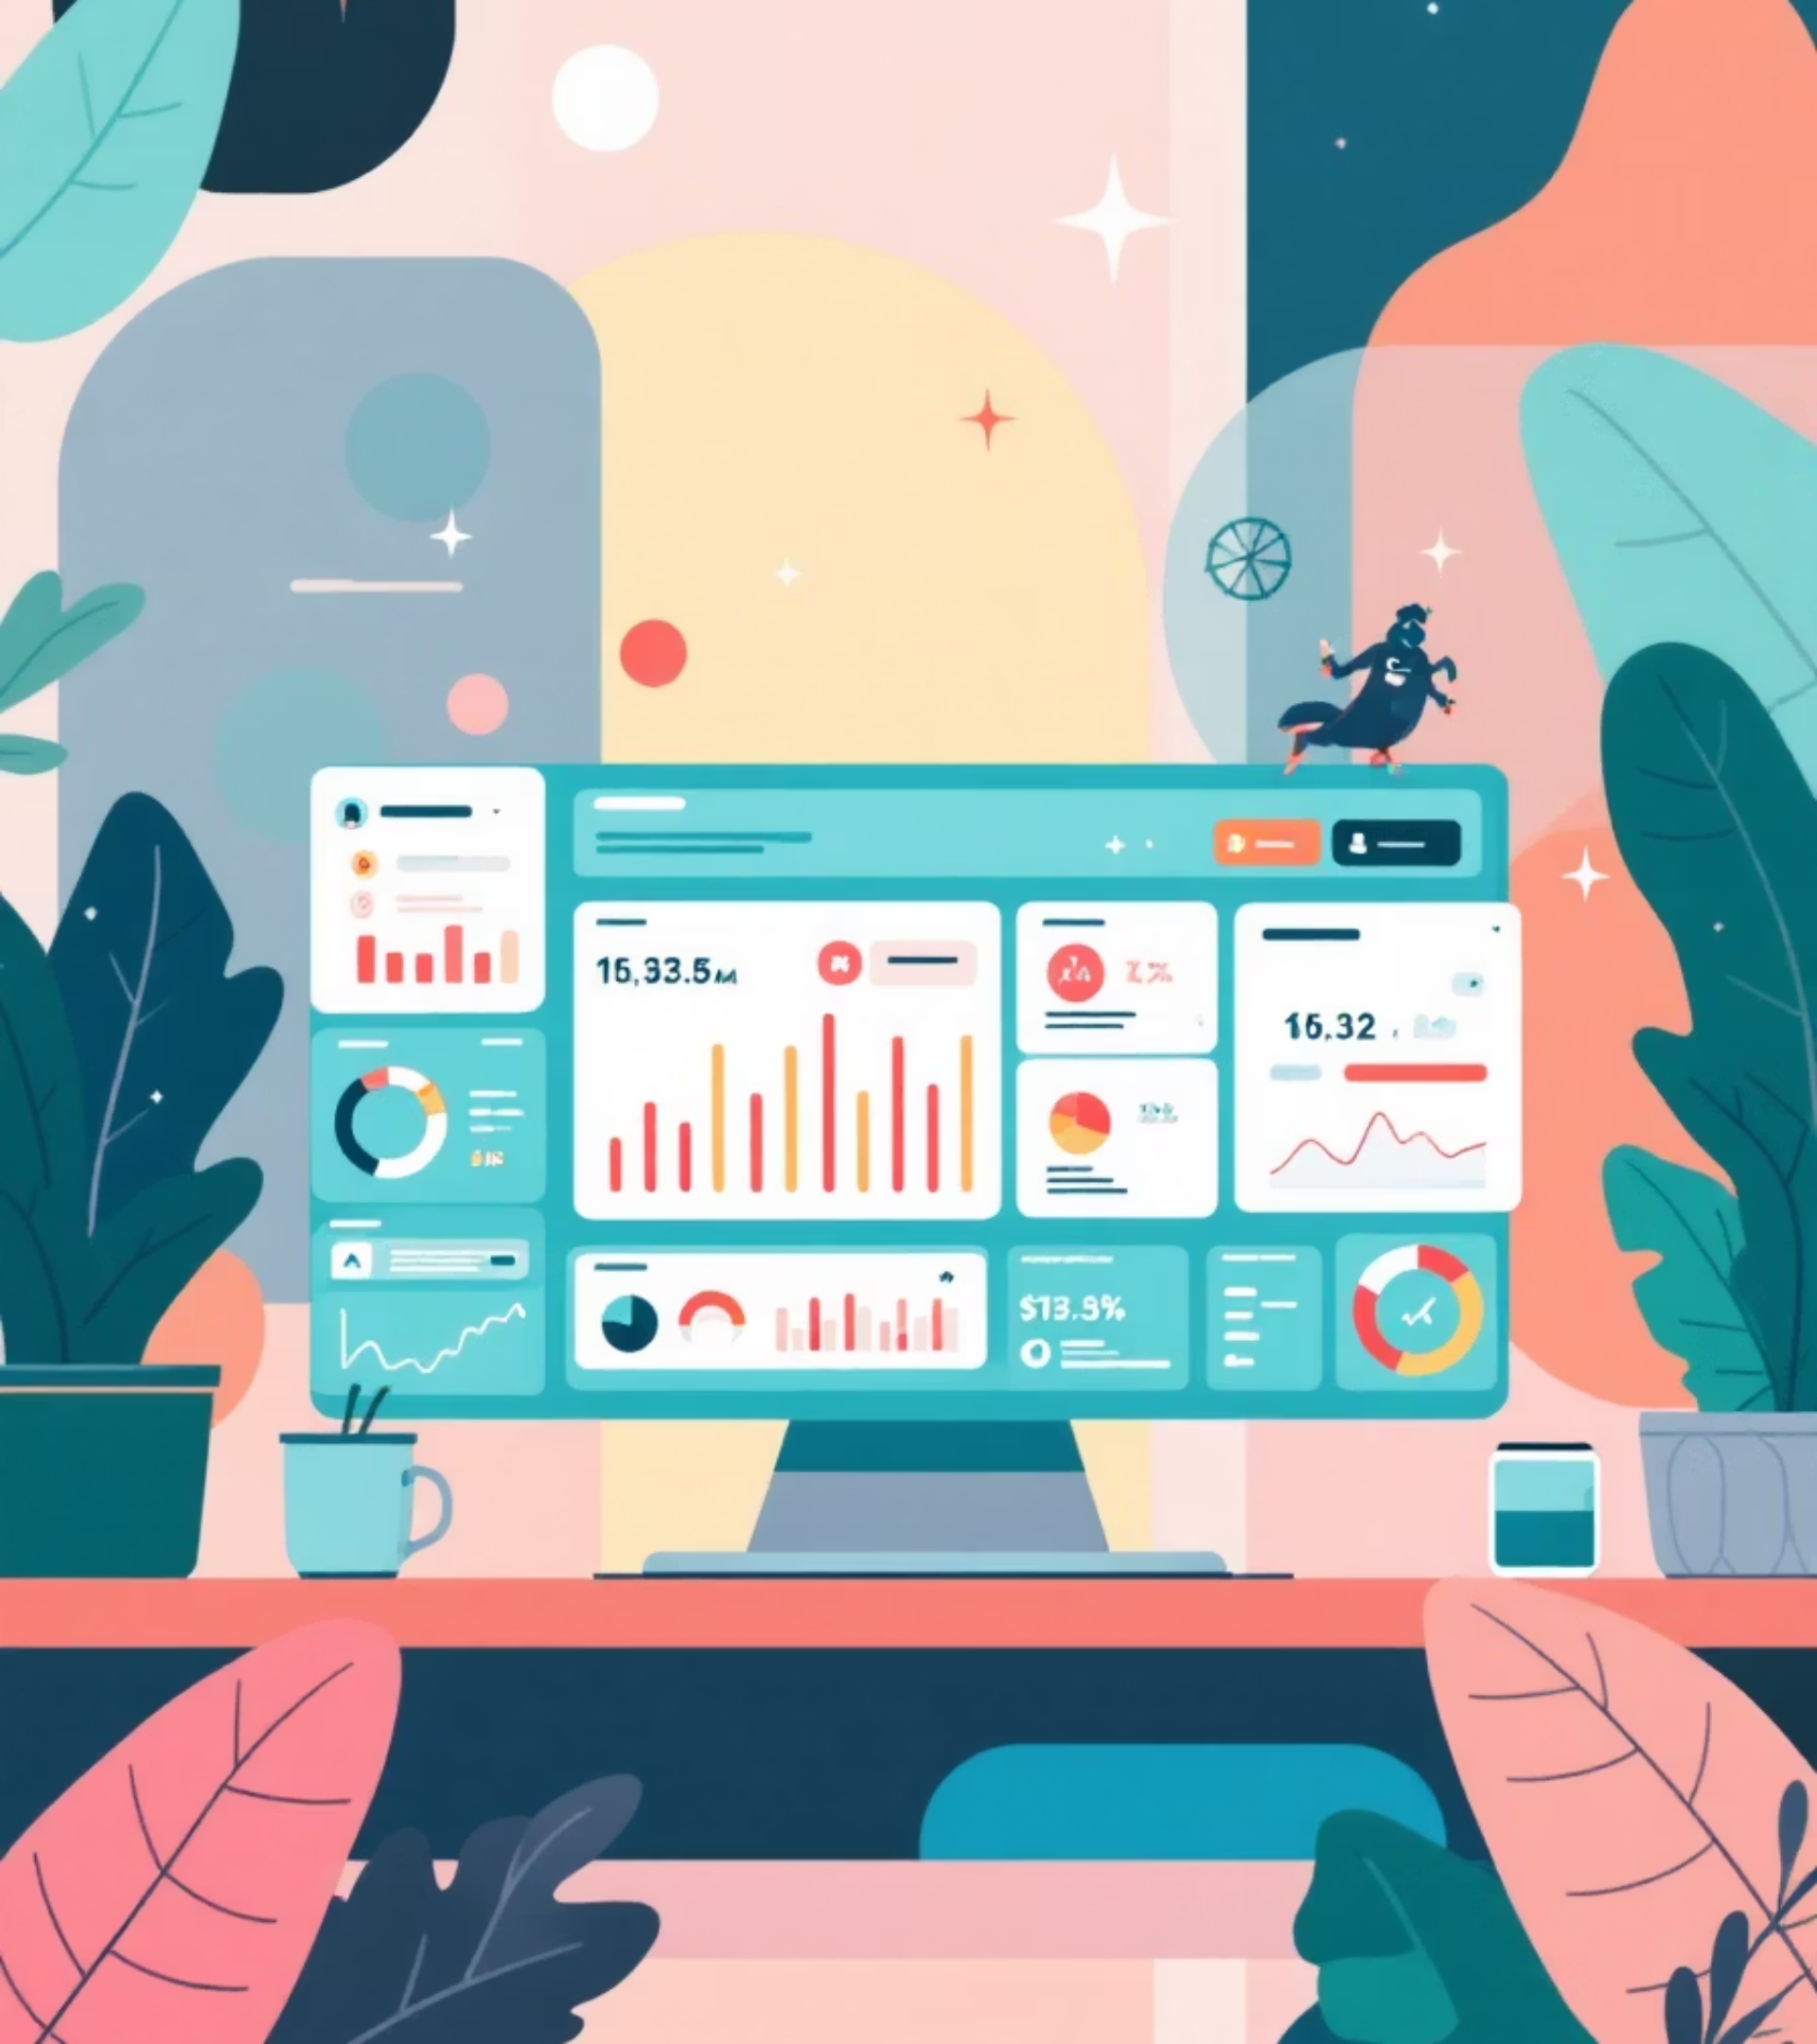
Deep Dive: Tredence Solutions Architecture and Frameworks
Customer Cosmos
Tredence's flagship customer intelligence platform designed as an end-to-end CDP (Customer Data Platform) that consolidates omnichannel customer data into a unified, AI-ready foundation for personalization and marketing optimization.

Slide 6
Customer Cosmos Architecture
01
02
03
Data Foundation Layer
Enrichment Layer
Feature Engineering Layer
Aggregates first-party transactional, clickstream, loyalty, and app data from multiple sources
Integrates third-party data partnerships (demographics, behavioral, purchase intent)
Generates 200+ customer attributes including recency, app downloads, subscription tenure, clickstream behaviors
04
05
Analytics Layer
Activation Layer
Applies 80+ pre-built ML models (CLTV, propensity, churn, price sensitivity, headroom analysis)
Enables real-time personalization and orchestrated customer experiences across touchpoints
Technology Stack: Built on Google Cloud Platform (BigQuery, Vertex AI, Cloud Composer) with semantic data layer and pre-defined metrics reducing cloud costs through centralized feature stores
Project Duration & Implementation: Enables 360-degree customer view deployment within weeks rather than traditional years; one case study showed a large apparel retailer completed implementation over the course of a year for foundational work, then core Cosmos deployment in months
Pricing/Project Scope: Enterprise licensing model; typical engagements range from $500K-$2M+ depending on data complexity, customer base size, and activation scope; outcomes-based options available
Key Outcomes: Enables personalized campaigns, customer journey optimization, omnichannel experience delivery, and increased customer lifetime value through targeted interventions

Slide 7

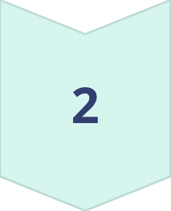
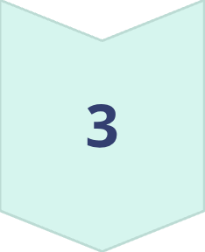
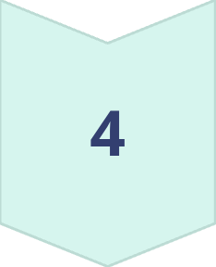
Marketing Data Model & Unified Marketing Platform (UMP)
What It Is
Architecture
The Unified Marketing Platform powered by Market Mix Modeling (MMM) optimizes marketing decision-making through AI/ML-enabled budget allocation and campaign effectiveness measurement.
Data Lake Layer
Consolidates marketing spend, channel performance, customer response, and external variables
Framework Approach
ML Analytics Layer
Integrates marketing, finance, and planning functions into unified decision-making
15+ accelerators for customer science, journey analytics, and measurement
Puts customer at center through AI/ML analytics and visualization
Decision Layer
Addresses fragmented data silos and inefficient manual models
MMM models, budget optimization engine, scenario planning capabilities
Multi-persona Consumption
Built-in dashboards, ad-hoc query simulators, marketing-friendly interfaces
Project Duration: Typically 6-12 months for full MMM deployment depending on data maturity and channel complexity
Pricing: Enterprise SaaS model with variable component based on marketing budget size and ROI achieved

Slide 8
Test & Learn Platform (TALP)
What It Is: An AI-powered experimentation platform designed for marketing, digital, and retail environments enabling systematic test design, measurement, and learning to drive continuous optimization.
1
2
Experiment Design Module
Measurement Engine
Proactive system recommendations and ML techniques for optimal experiment design with proper control matching
360-degree real-time performance visibility across sales, profit, traffic, and shopper response metrics
3
4
Adjacent Learning Module
Implementation
Cross-experiment insights to drive enterprise-wide adoption and virtuous improvement cycles
Native Azure components (Data Factory, Data Lake, SQL DB, Analysis Services)
Framework Approach: Addresses enterprise challenges of legacy testing platforms, limited experimentation learning, and broken campaign effectiveness readouts
Project Duration: Typically 3-6 months for platform setup and initial test suite deployment; ongoing usage scales indefinitely
Pricing: Platform licensing with usage-based components; typical engagements $200K-$500K annually

Slide 9
Customer Journey Explorer & Customer Engagement Driver
Customer Journey Explorer
Customer Engagement Driver
What It Is: An AI-powered customer insights solution (also branded as Sage CX) that maps customer journeys and extracts actionable insights from customer feedback signals for experience optimization.
What It Is: A suite of five integrated platforms for orchestrating personalized, AI-driven customer engagement at scale across omnichannel touchpoints.
Components & Architecture
Architecture
WordCraft: Content-as-a-service platform generating personalized content across 100+ languages and multiple channels (email, web, SMS) with centralized management
Journey Mapping Layer: Visualizes customer touchpoints across channels and identifies friction areas
ABI (Abbey): A/B testing automation platform enabling scaled experimentation with automated segmentation and analysis for experience optimization
NLP/ML Extraction: Analyzes customer feedback, survey data, and interaction transcripts to identify drivers and sentiment
Customer Lifecycle Manager: Coordinates omnichannel customer journey design, integrating data science models and experimentation with intelligent timing decisions
Context Integration: Connects journey signals to customer segment data, lifecycle stage, and historical impact
Decision Engine: Central orchestration brain combining customer journey, personalization, and experimentation logic
Activation Layer: Provides real-time alerts and recommendations for experience improvement
Engagement Execution Engine: Activates coordinated customer interactions across channels based on decision logic
Framework Approach: Customer-centric view instead of transaction-centric; contextual understanding of customer value and experience drivers
Framework Approach: Multi-layer orchestration ensuring consistent, personalized experiences through automated decision-making
Project Duration: 4-8 months for comprehensive journey mapping and insight extraction deployment
Project Duration: 6-12 months for full suite deployment including journey design, model development, and integration
Pricing: Engagement-based with outcomes metrics; typical projects $300K-$800K depending on complexity
Pricing: Enterprise licensing with implementation services; typical total cost of engagement (TCO) $1M-$3M+ for large-scale implementations

Slide 10

Tredence Solutions deliver enterprise-scale AI and data platforms
From Customer Cosmos to Customer Engagement Driver, Tredence's comprehensive solution architecture enables Fortune 500 companies to transform customer intelligence, marketing optimization, and personalized engagement through AI-powered platforms built on leading cloud technologies.

